Slide 1
Image Classification based on scenery
Project guide
Shantala giraddi
Presented by
Sindhu Hachadad
Shrinivas Miskin
Shriya Bannikop
Sushmita Talawar

Slide 2
Problem Statement
Scene Image Classification: Identify which kind of natural scenes can the image be categorised into.

Slide 3
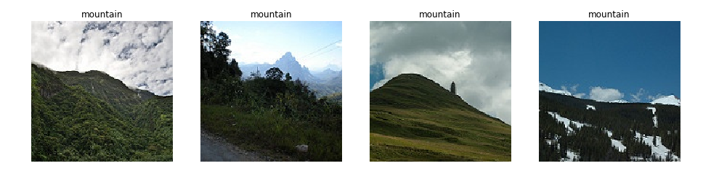
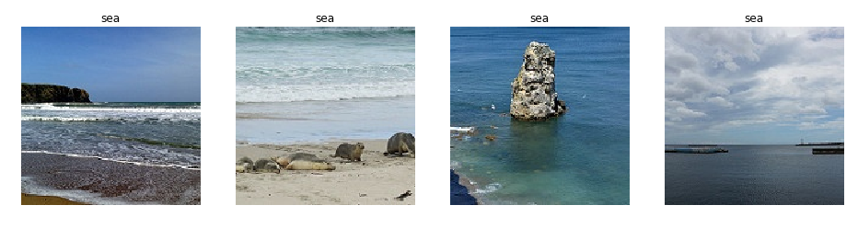
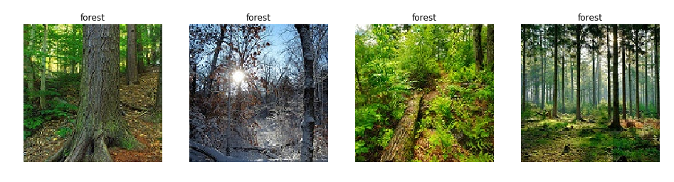
Image dataset

Slide 4
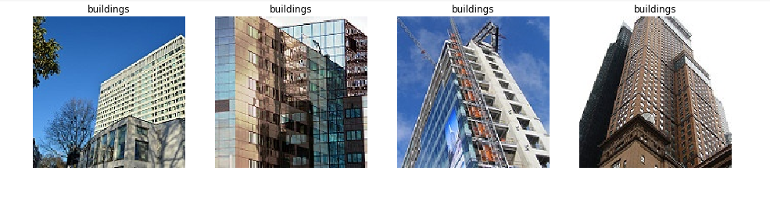
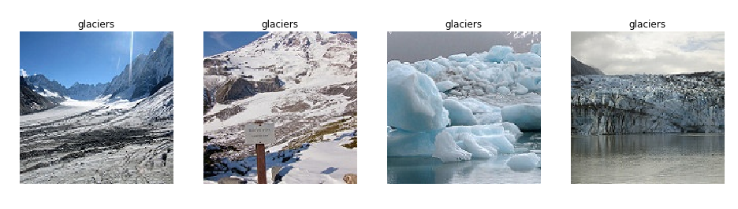
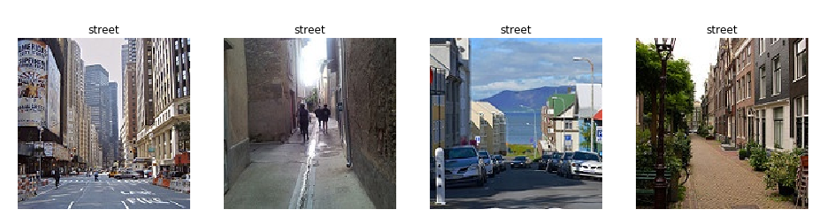

Slide 5
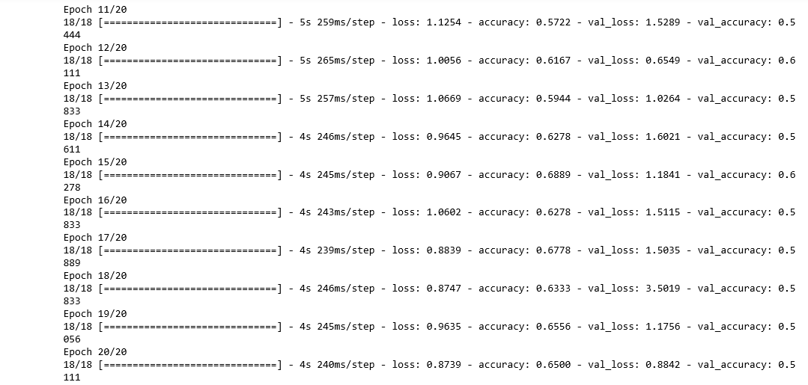
Status of implementation
Model 1

Slide 6
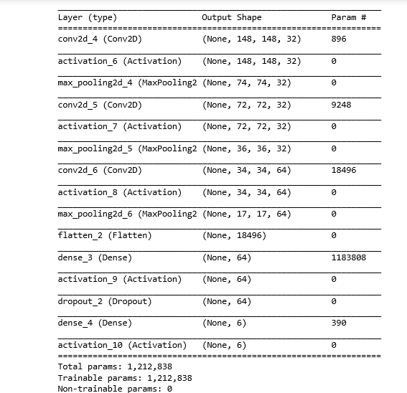

Slide 7
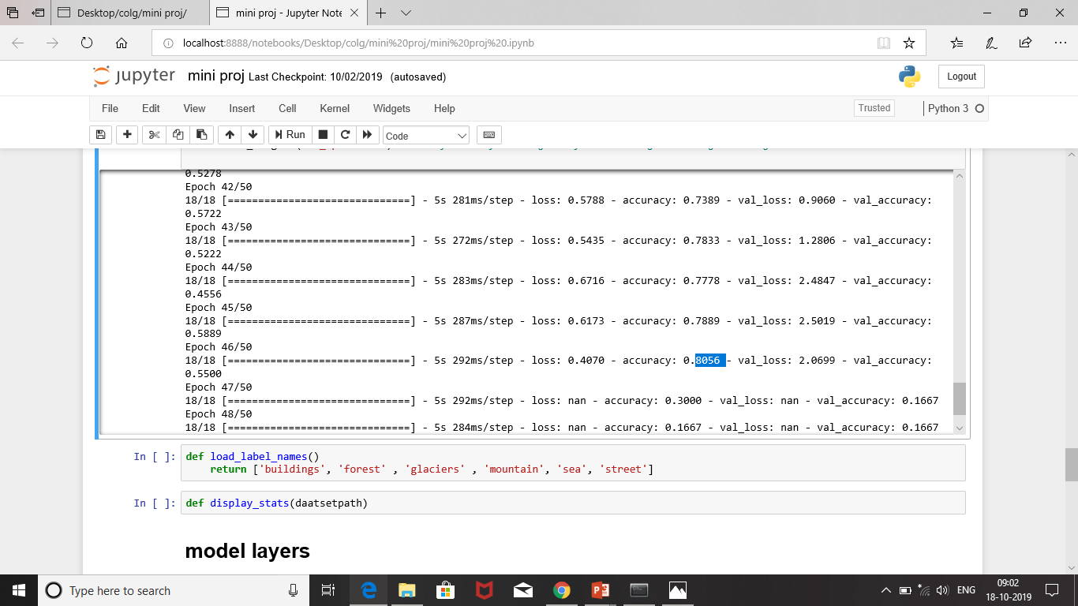
Model 2

Slide 8
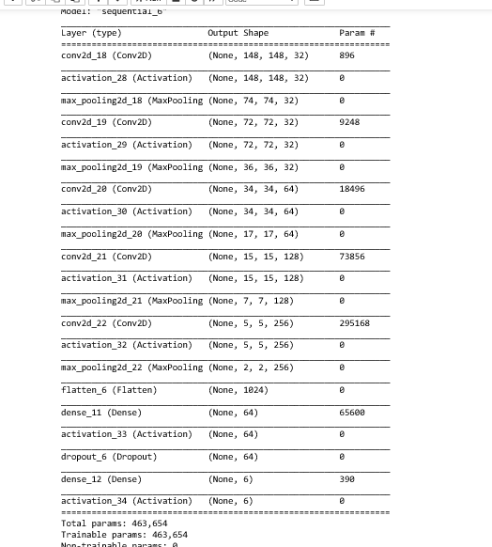

Slide 9
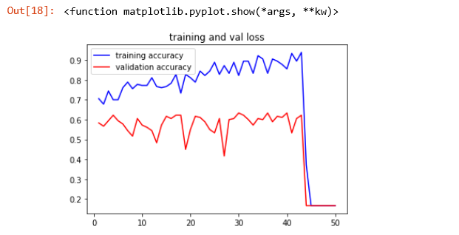
Overfitting(model 2)

